Slide 1
Lab Environment Lab Objectives

Slide 2
Workshop envionment
Azure Cosmos DB
The different labs are:
LAB01-Load Data Into Cosmos DB with ADFMigrate the OnPremise database into Azure
LAB02-Querying and Indexing in Azure Cosmos DB
LAB03-Data modeling
LAB04-ChangeFeed
LAB05-Synapse Link
Notes:
With

Slide 3







Workshop environment
The main resources
Resource Group:
24 Azure virtual machines (one for each user)
vmTeam01 -> vmTeam24
24 Azure Data factory (One for each user)
Resource Group:
Cosmos DB Account
Azure Synapse Workspace
Azure virtual network
Azure Blob Storage account
Azure Bastion
Notes:
With

Slide 4
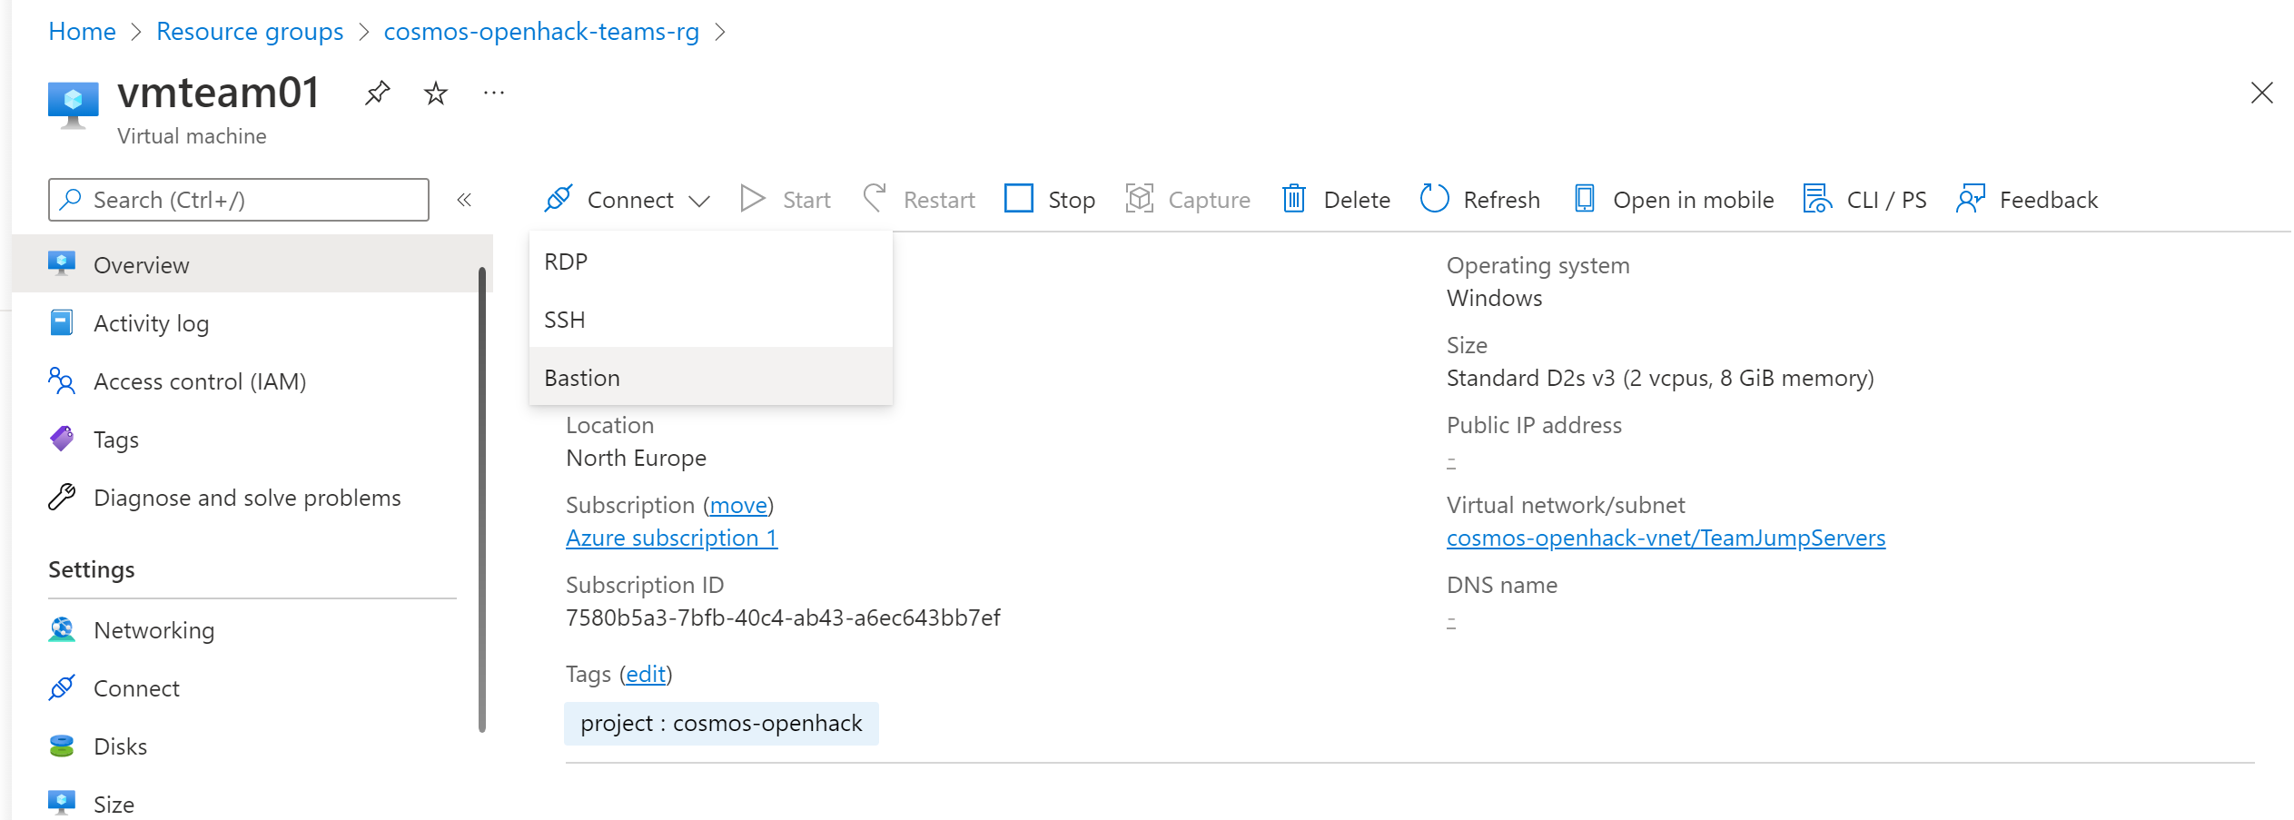
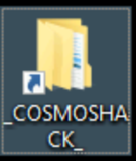
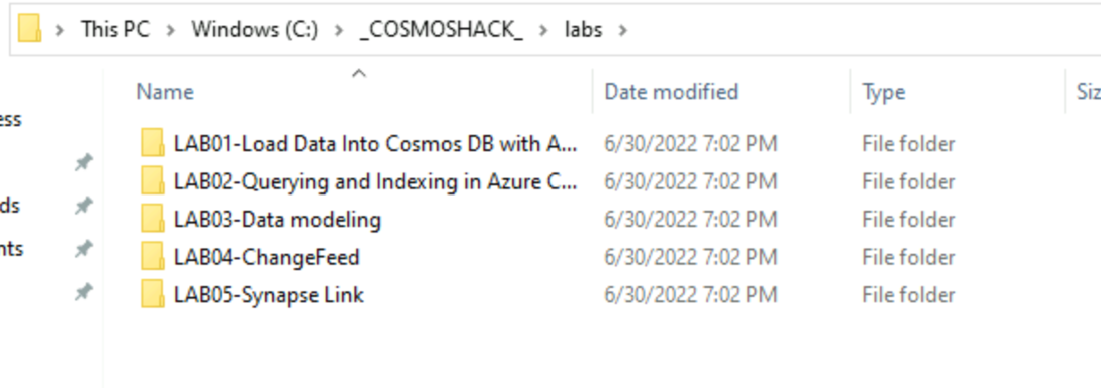
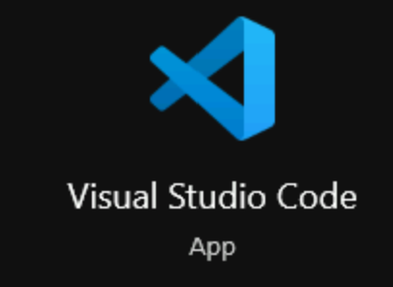
Workshop environment
Jump Server
Each user has a Jump Server
Windows 10 connection via Bastion
On the desktop a shortcut with the lab files
A set of tools installed
Notes:
With

Slide 5
Logins and Accounts USED
Used for | Username | Password | Machine Name/IP Address/Address/Instance Name
Win10 VM windows login for RDP
Azure portal domain account
Legacy SQL2008 SQL login used by the dummy application
Legacy SQL2008 SQL login sysadmin
Azure SQL Managed Instance sysadmin
Notes:
With

Slide 6

Q&A

